Slide 1
Introduction
The interactive C quiz program is a console-based application designed to provide users with an engaging and educational experience through a series of quiz questions.
.

Slide 2
Features
User-Friendly Interface: The console-based interface is easy to navigate, making it accessible to a wide range of users.
Question Display: Questions are presented with multiple-choice options to test users on various subjects.
Scoring System: A scoring system keeps track of the user's performance throughout the quiz.
Hint Functionality: Users receive hints for incorrect answers, promoting a learning-oriented experience.
Dynamic Feedback: Immediate feedback informs users whether their answers are correct, and they have the opportunity to retry after a hint.

Slide 3
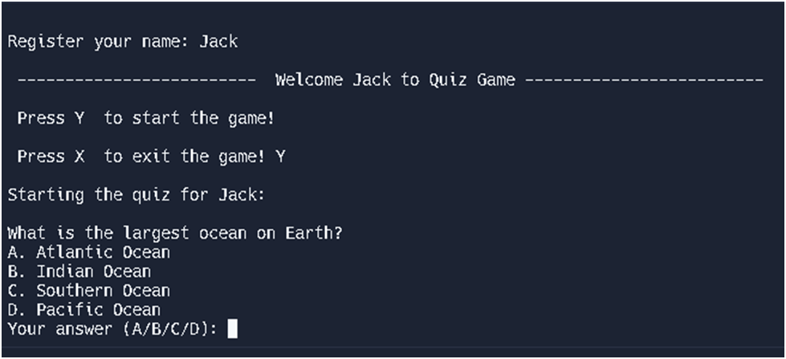

Slide 4
